Slide 1
Calibration of Space Charge and Grid Leak
Xiaohai Jin
Feb 25 2019

Slide 2
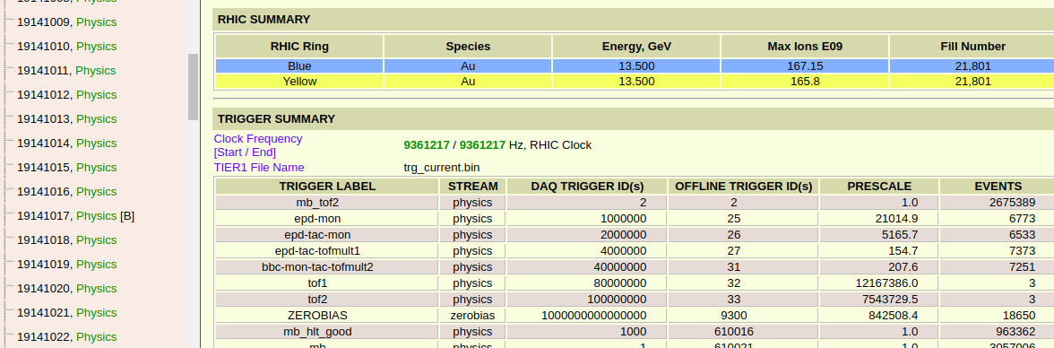
Run Information

Slide 3
Daq File
/star/data03/daq/2018/141/19141020/st_physics_19141020_raw_2000011.daq
/star/data03/daq/2018/143/19143007/st_physics_19143007_raw_4000015.daq
/star/data03/daq/2018/145/19145006/st_physics_19145006_raw_5000006.daq
/star/data03/daq/2018/147/19147047/st_physics_19147047_raw_1500014.daq
/star/data03/daq/2018/149/19149031/st_physics_19149031_raw_3500008.daq
/star/data03/daq/2018/155/19155058/st_physics_19155058_raw_3000007.daq
/star/data03/daq/2018/157/19157003/st_physics_19157003_raw_5500010.daq
/star/data03/daq/2018/159/19159007/st_physics_19159007_raw_2500016.daq
/star/data03/daq/2018/161/19161050/st_physics_19161050_raw_1500014.daq
/star/data03/daq/2018/163/19163014/st_physics_19163014_raw_2000017.daq
/star/data03/daq/2018/165/19165021/st_physics_19165021_raw_3000001.daq
/star/data03/daq/2018/167/19167004/st_physics_19167004_raw_1500012.daq
/star/data03/daq/2018/168/19168034/st_physics_19168034_raw_1500013.daq
/star/data03/daq/2018/144/19144031/st_physics_19144031_raw_1500014.daq
/star/data03/daq/2018/148/19148011/st_physics_19148011_raw_1500014.daq

Slide 4
Code and Data Directory
Code Directory:
1. /star/u/jhai/WorkCode/SCGL_27GeV/EventPass (SC = 0, GL = 8, 9, 10)
2. /star/u/jhai/WorkCode/SCGL_27GeV/EventPass_1 (SC = 2.649e-5, GL = 8, 9, 10)
3. /star/u/jhai/WorkCode/SCGL_27GeV/EventPass_2 (SC = 6.843e-6, GL = 10.6, 11.6, 12.6)
4. /star/u/jhai/WorkCode/SCGL_27GeV/EventPass_3 (SC = 1.818e-6, GL = 7.65, 8.65, 9.65)
5. /star/u/jhai/WorkCode/SCGL_27GeV/EventPass_4 (SC = 1.608e-6, GL = 6.02, 7.02, 8.02)
event.root Directory:
1. /star/u/jhai/gpfs01/DATA/Service/27GeV/EventPass
2. /star/u/jhai/gpfs01/DATA/Service/27GeV/EventPass_1
3. /star/u/jhai/gpfs01/DATA/Service/27GeV/EventPass_2
4. /star/u/jhai/gpfs01/DATA/Service/27GeV/EventPass_3
5. /star/u/jhai/gpfs01/DATA/Service/27GeV/EventPass_4

Slide 5
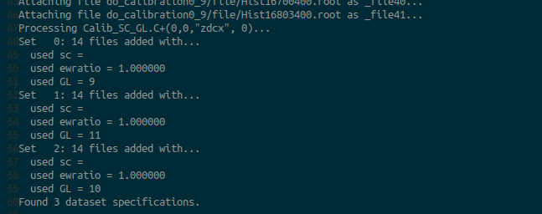
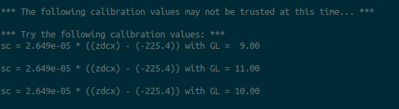
Pass0 SC = 0, GL = 8, 9, 10

Slide 6
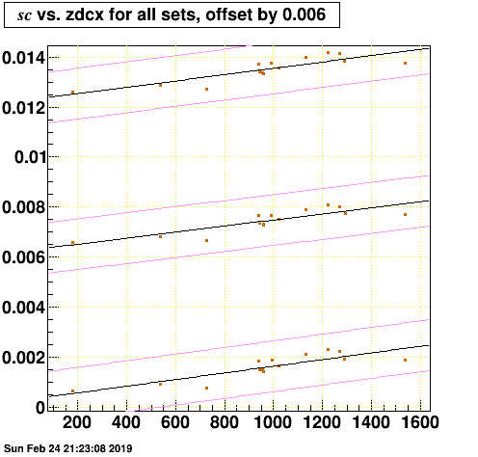
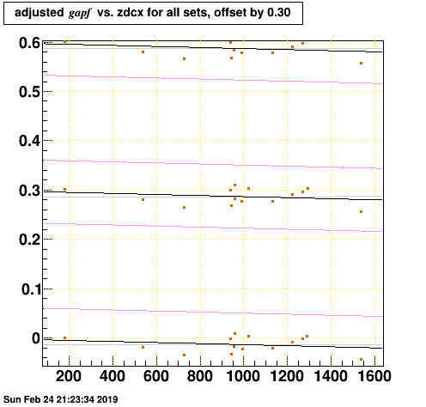
Pass0 SC = 0, GL = 8, 9, 10

Slide 7
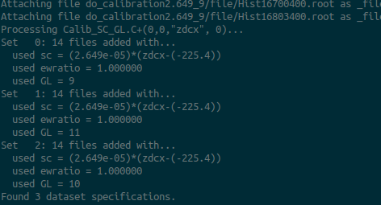

Pass1 SC = 2.649e-5, GL = 8, 9, 10

Slide 8
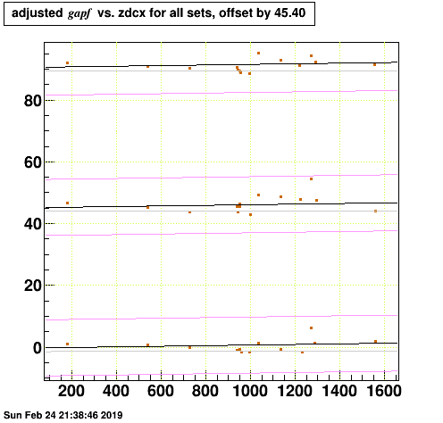
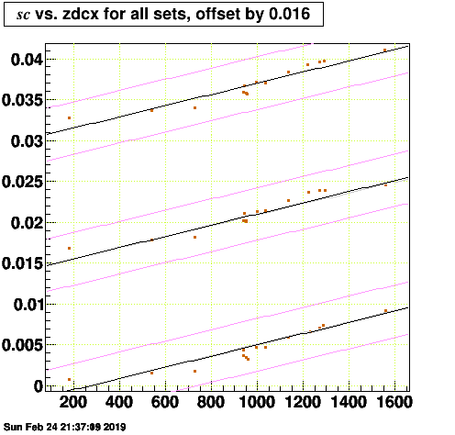
Pass1 SC = 2.649e-5, GL = 8, 9, 10

Slide 9
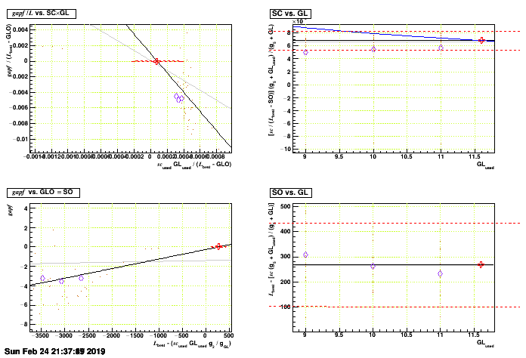
Pass1 SC = 2.649e-5, GL = 8, 9, 10

Slide 10
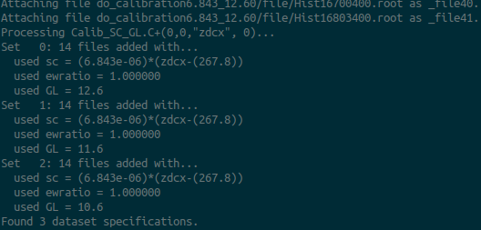

Pass2 SC = 6.843e-6, GL = 10.6, 11.6, 12.6

Slide 11
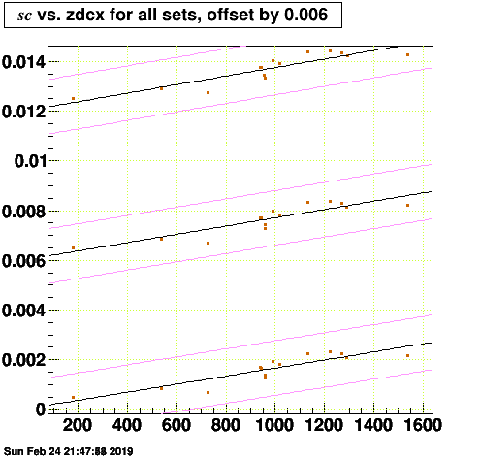
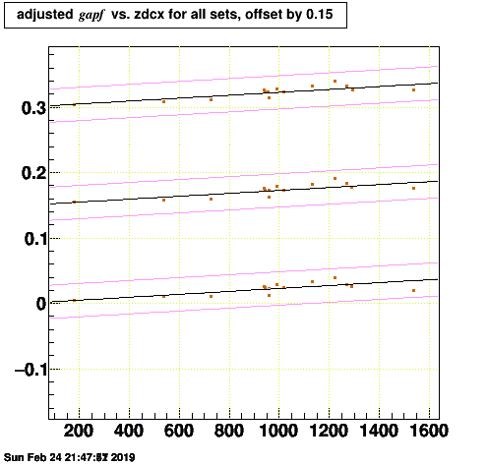
Pass2 SC = 6.843e-6, GL = 10.6, 11.6, 12.6

Slide 12
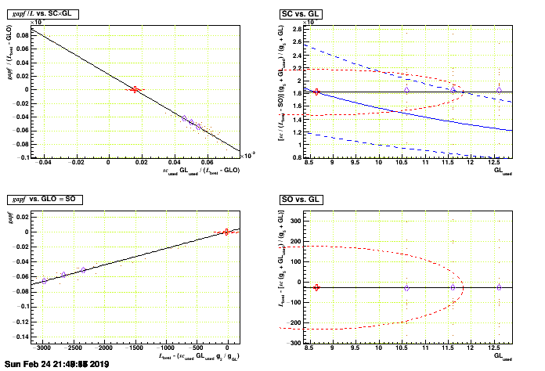
Pass2 SC = 6.843e-6, GL = 10.6, 11.6, 12.6

Slide 13
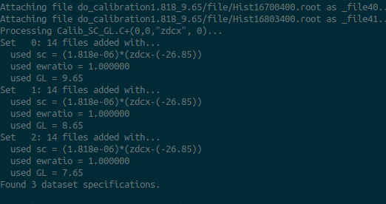

Pass3 SC = 1.818e-6, GL = 7.65, 8.65, 9.65

Slide 14
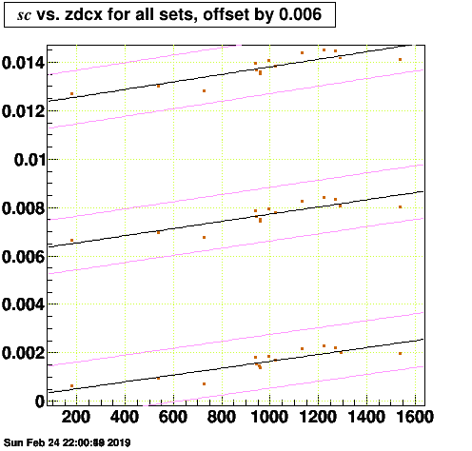
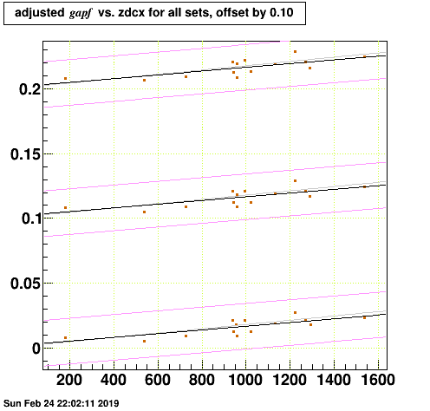
Pass3 SC = 1.818e-6, GL = 7.65, 8.65, 9.65

Slide 15
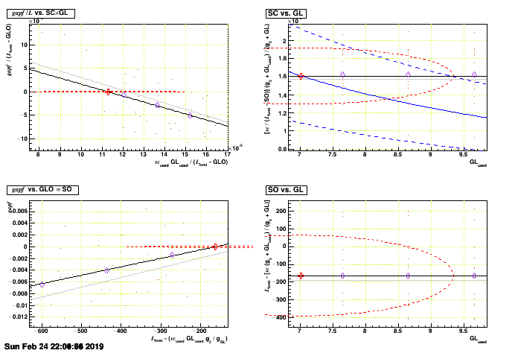
Pass3 SC = 1.818e-6, GL = 7.65, 8.65, 9.65

Slide 16
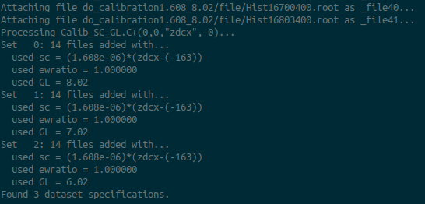

Pass4 SC = 1.608e-6, GL = 6.02, 7.02, 8.02

Slide 17
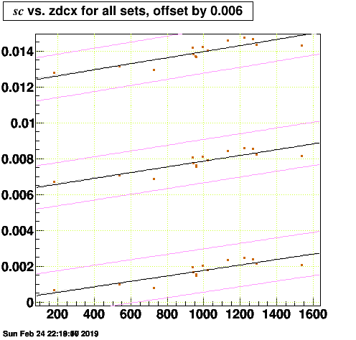
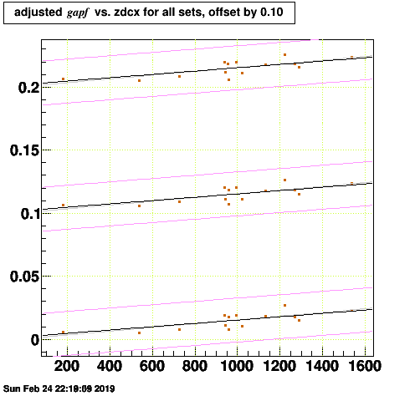
Pass4 SC = 1.608e-6, GL = 6.02, 7.02, 8.02

Slide 18
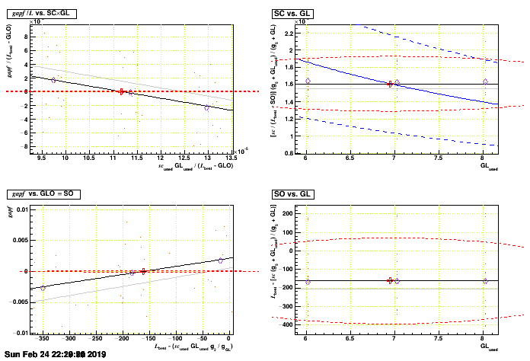
Pass4 SC = 1.608e-6, GL = 6.02, 7.02, 8.02

Slide 19
Final Result
sc = (1.608e-06 +/- 3.194e-07) * ((zdcx) - (-162.1 +/- 232.7))
GL = 6.95 +/- 2.44

